Slide 1

Movie Sales Analysis
Presentation by:- K.Rohith Reddy
Ch.Kalyan

Slide 2
Agenda
Problem Statement
Objective
Dataset Overview
Data Preparation & Cleaning
Dashboard Visualizations
Applications & Recommendations
Conclusion & Future Scope

Slide 3
Business Problem:-
Movie companies, streaming platforms, and distributors struggle to understand what factors truly drive movie success. With large datasets containing revenue, ratings, genres, votes, directors, and runtimes, it becomes difficult to manually identify:
Which years or genres perform the best
Which directors or movies generate the highest revenue
How ratings, votes, and runtime influence box office performance
Without proper analysis, studios may invest in the wrong genres, choose less impactful directors, or make movies that fail to attract audiences.
A Movie Sales Analysis Dashboard is needed to uncover performance trends, identify top contributors, and support data-driven decisions for future movie production and marketing.

Slide 4
Problem Statement:-
The movie industry generates massive sales data across regions, genres, and time.
Raw sales data is complex and difficult to interpret without analysis.
Stakeholders need insights on revenue, trends, and performance.
This project analyzes movie sales data using Power BI dashboards.

Slide 5
Objective:-
Analyze movie sales and revenue trends
Understand genre-wise and year-wise performance
Create interactive dashboards for insights
Support business and marketing decisions

Slide 6
Dataset Overview:-
Dataset Name: Movie Sales Analysis
Source: CSV files (Monthly data)
File Type: CSV
Years Covered: 2006 – 2016
Key Columns:
Movie Title
Genre
Release Year
Runtime (Minutes)
IMDb Rating
Votes
Metascore
Revenue (Millions)
Director / Actors

Slide 7
Data Preparation & Cleaning:-
Imported multiple CSV files into Power BI
Removed duplicates and null values
Standardized column names
Created measures: Total Sales, Total Revenue, Average Rating
Handled missing and inconsistent data

Slide 8
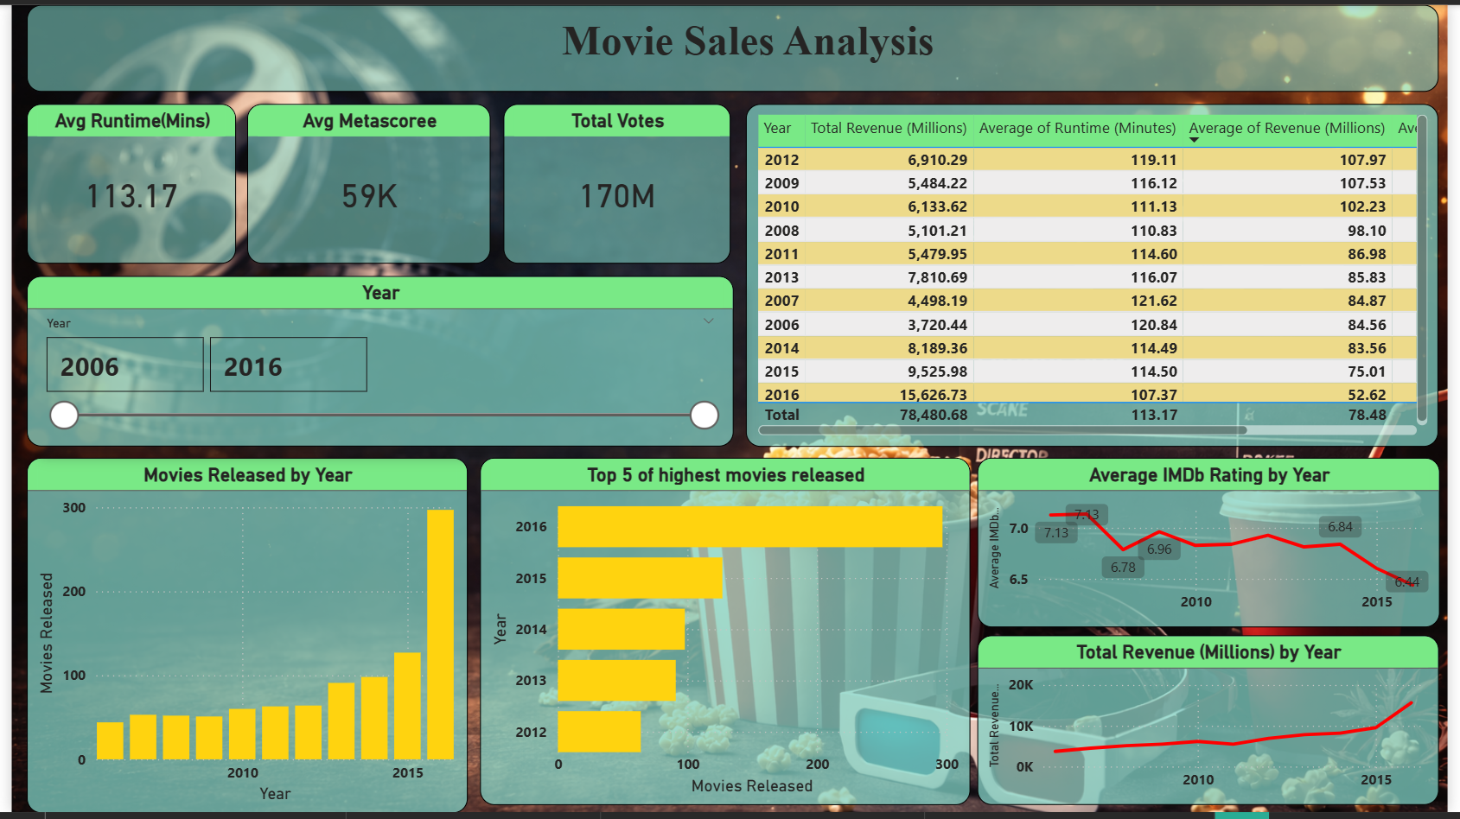
Dashboard Visualizations:-

Slide 9
Movie Overview & Time Trends:-
Visuals Used:
KPI Cards: Avg Runtime, Avg Metascore, Total Votes
Year Slicer
Table: Year-wise Revenue, Avg Runtime, Avg Revenue
Column Chart: Movies Released by Year
Bar Chart: Top 5 Years with Highest Releases
Line Charts: Average IMDb Rating by Year, Total Revenue by Year
Purpose: To analyze year-wise trends in movie releases, revenue growth, ratings, and runtime, and to provide a high-level summary of industry performance over time.

Slide 10
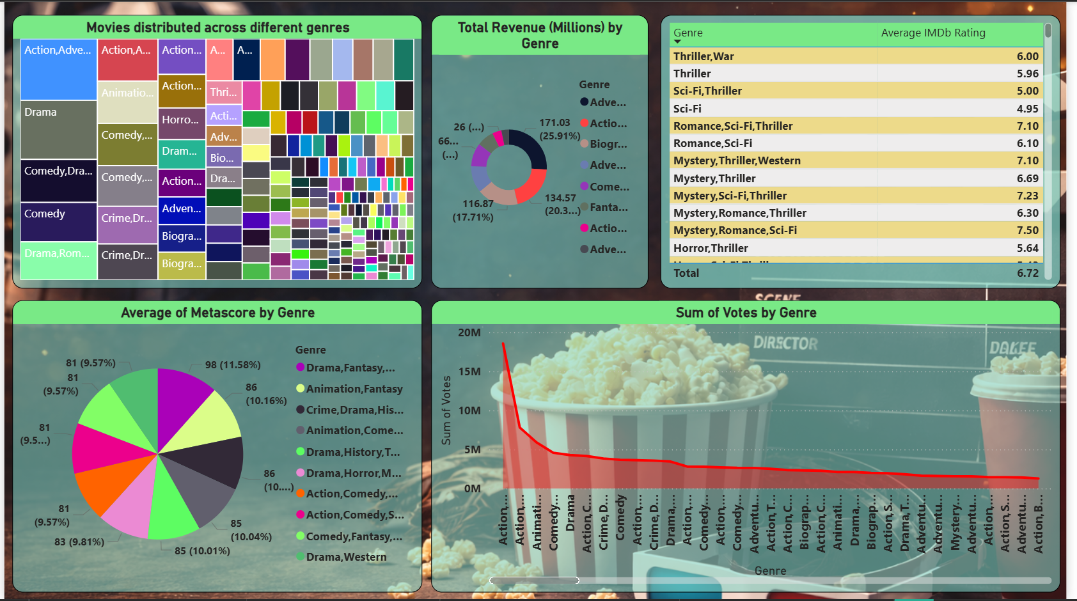

Slide 11
Genre & Rating Analysis:-
Visuals Used:
Treemap: Movies Distributed Across Genres
Donut Chart: Total Revenue by Genre
Table: Average IMDb Rating by Genre
Pie Chart: Average Metascore by Genre
Line / Area Chart: Sum of Votes by Genre
Purpose: To understand genre-wise distribution, identify revenue-dominant genres, compare audience ratings and critic scores, and analyze genre popularity.

Slide 12
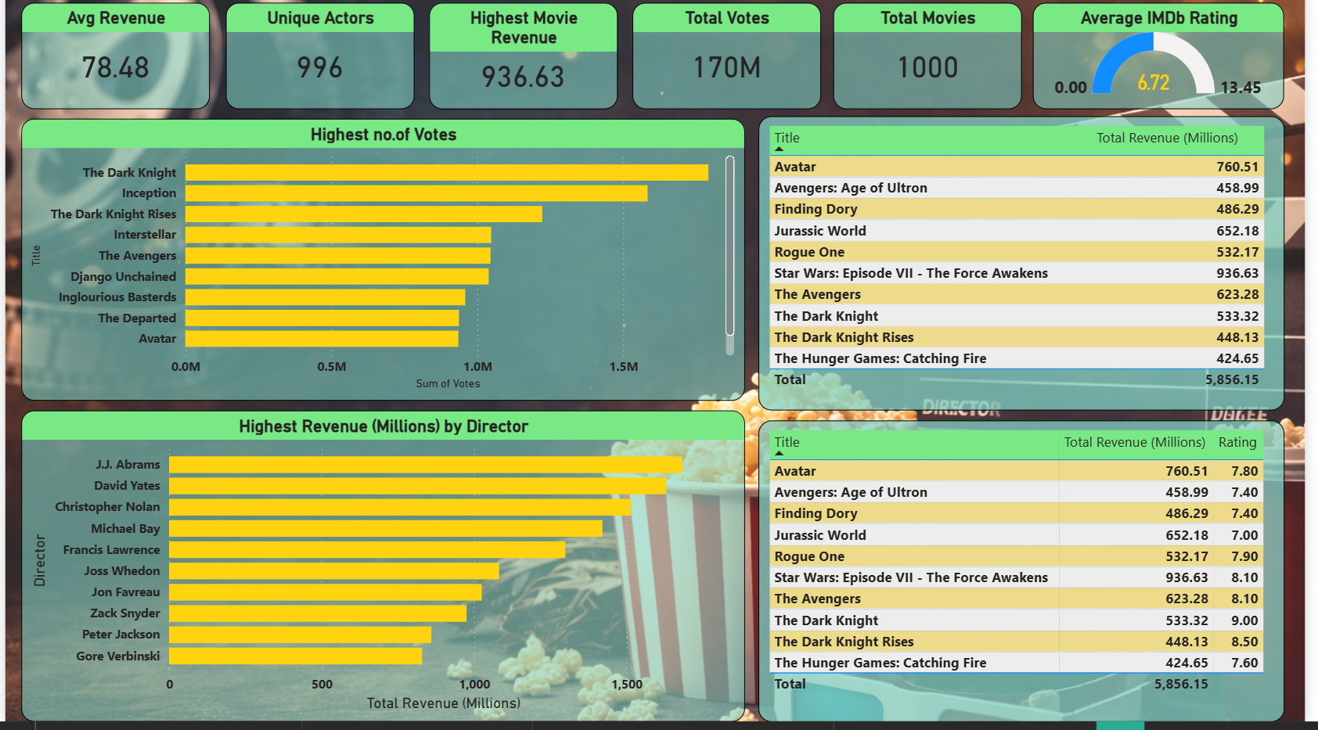

Slide 13
Top Performers & Box Office Insights:-
Visuals Used:
KPI Cards: Avg Revenue, Highest Revenue, Total Movies, Total Votes, Avg IMDb
Bar Chart: Movies with Highest Number of Votes
Table: Top Movies by Total Revenue
Bar Chart: Highest Revenue by Director
Table: Movie Revenue with IMDb Rating
Purpose: To identify top-performing movies and directors, analyze audience engagement, and evaluate box office success.

Slide 14
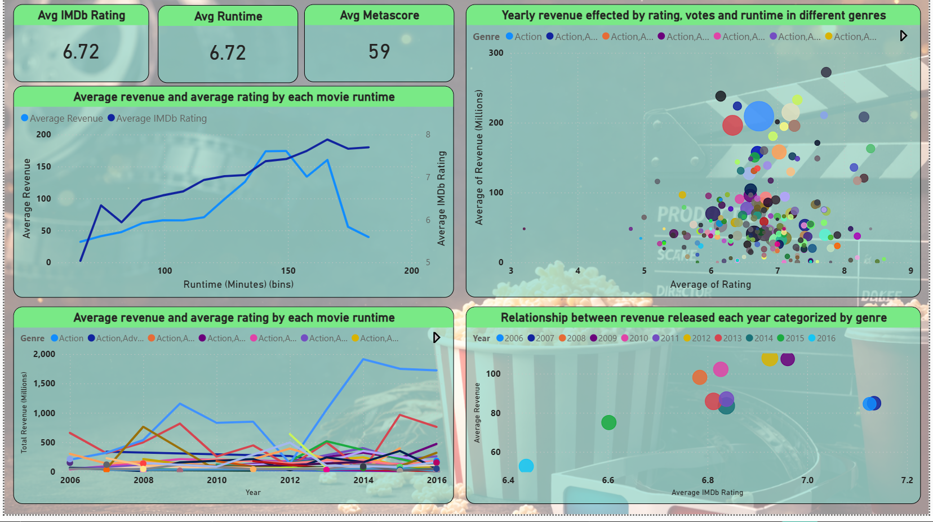

Slide 15
Correlation & Advanced Metrics:-
Visuals Used:
KPI Cards: Avg IMDb Rating, Avg Runtime, Avg Metascore
Dual-Axis Line Chart: Avg Revenue & Avg Rating by Runtime
Scatter Plot: Revenue vs IMDb Rating by Genre
Multi-Line Chart: Revenue Trend by Genre Over Years
Bubble Chart: Revenue vs Rating by Year
Purpose: To analyze relationships and correlations between revenue, ratings, runtime, genre, and time, and to identify key factors influencing box office performance.

Slide 16
Applications & Recommendations:-
Applications
Identifies high-revenue and popular genres
Helps plan movie release timing using year-wise trends
Supports selection of top-performing directors
Analyzes audience engagement using votes and ratings
Assists investors in data-driven decisions
Recommendations
Focus on genres with strong revenue and ratings
Prefer optimal runtime range for better performance
Invest in directors with consistent box-office success
Align marketing with high-engagement movies
Use historical trends for strategic planning

Slide 17
Conclusion & Future Scope:-
Conclusion
Power BI simplifies movie sales trend analysis
Year-wise and genre-wise insights improve understanding
Ratings and votes influence revenue, but no single factor dominates
Dashboards provide interactive and actionable insights
Future Scope
Add latest and global movie data
Include budget and profit analysis
Integrate OTT platform performance
Apply predictive models for revenue forecasting
Enable real-time Power BI dashboards

Slide 18

THANK YOU

